Slide 1
Basic Relationship between pixels

Slide 2
Contents
Neighborhood
Adjacency
Connectivity
Paths
Regions and boundaries

Slide 3
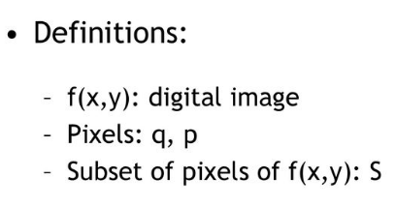
Relationship between pixels

Slide 4
Conventional indexing method
y
(0,0)
(x-1, y-1) | (x-1,y) | (x-1,y+1)
(x,y-1) | (x,y) | (x,y+1)
(x+1, y-1) | (x+1,y) | (x+1, y+1)
x

Slide 5
Neighbors of a pixel
N₄(P): 4-neighbors of p
(x-1, y-1) | (x-1,y) | (x-1,y+1)
(x,y-1) | (x,y) | (x,y+1)
(x+1, y-1) | (x+1,y) | (x+1, y+1)

Slide 6
: four diagonal neighbors of p
(x-1, y-1) | (x-1,y) | (x-1,y+1)
(x,y-1) | (x,y) | (x,y+1)
(x+1, y-1) | (x+1,y) | (x+1, y+1)

Slide 7
N₈(P): 8-neighbors of p
N₄(P) and N_{D}(P)
(x-1, y-1) | (x-1,y) | (x-1,y+1)
(x,y-1) | (x,y) | (x,y+1)
(x+1, y-1) | (x+1,y) | (x+1, y+1)

Slide 8
Adjacency
V: The set of gray-level values used to define adjacency
4-adjacency: Two pixels p and q with values from V are 4-adjacent if q is in the set N₄(p).
8-adjacency: Two pixels p and q with values from V are 8-adjacent if q is in the set N₈(p).
V={0,1} V={1,2}
0 | 1 | 0
0 | 1 | 0
0 | 0 | 0
0 | 1 | 1
0 | 2 | 0
0 | 0 | 1

Slide 9
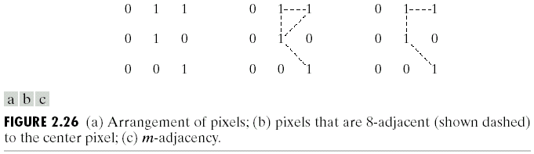
m-adjacency: Two pixels p and q with values from V are m-adjacent if
(i) q is in the set N₄(p), or
(ii) q is in the set N_{D}(p) and the set N₄(p) ∩ N₄(p) has no pixels whose values are from V.

Slide 10
Digital Path
A path from pixel p with coordinates (x, y) to pixel q with coordinates (s, t) is a sequence of distinct pixels with coordinates:
(x ₀, y ₀), (x ₁, y ₁), (x₂, y ₂) … (x _{n}, y _{n}), where (x ₀, y ₀)=(x, y) and
(x _{n},y_{n})=(s, t); (x _{i}, y _{i} ) is adjacent to (x_{i-1}, y_{i-1})
Length of path = n
4/8/m-paths

Slide 11
Connectivity
Connected Pixels:
If p and q are pixels of an image subset S then p is connected to q in S if there is a path from p to q consisting entirely of pixels in S
Connected component:
For every pixel p in S, the set of pixels in S that are connected to p is called a connected component of S
Connected Set:
If S has only one connected component then S is called Connected Set

Slide 12
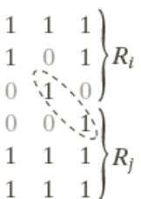
Region and boundary
Region: A subset R of pixels in an image is called a Region of the image if R is a connected set.
Adjacent Regions:

Slide 13
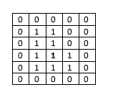
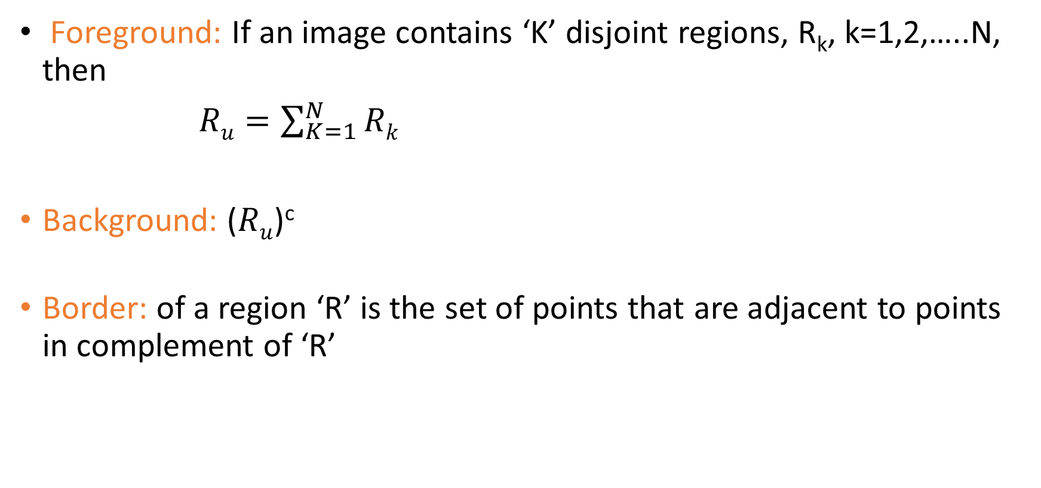
Border and Edge
Foreground: If an image contains ‘K’ disjoint regions, R_{k}, k=1,2,…..N, then
$Ru=\sum_{K=1}^{N}{Rk}$
Background: ($Ru$)^{c}
Border: of a region ‘R’ is the set of points that are adjacent to points in complement of ‘R’

Slide 14

Edge: It is intensity discontinuity
Edge point
Edge segment
border

Slide 15


Distance Measures

Slide 16
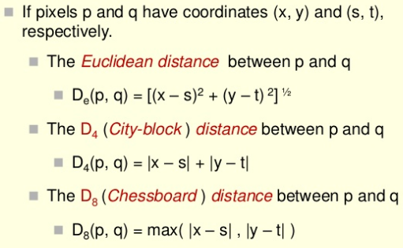
Types

Slide 17
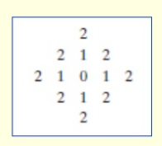
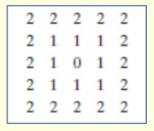
D₄<=2 from (x, y)
D₈<=2 from (x, y)

Slide 18
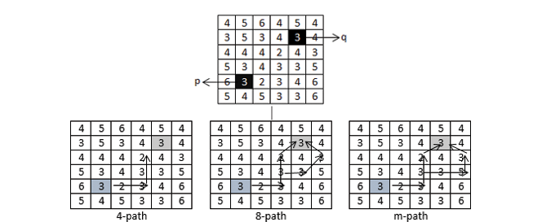
Practice Exercises
V= {2,3,5}

Slide 19
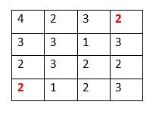
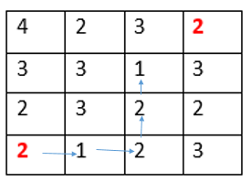
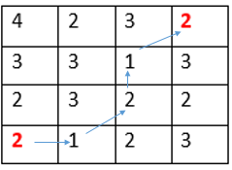
Compute shortest 4-, 8-, m-paths between pixels p and q where
V= {1, 2}

Slide 20
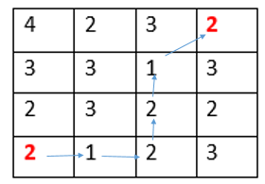

Slide 21
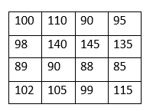
Consider the following matrix corresponding to pixel values of image.
Compute:
1) Spatial Resolution
2) Intensity resolution
3) Image contrast
4) Dynamic range
5) Gray scale

Slide 22
